Slide 1
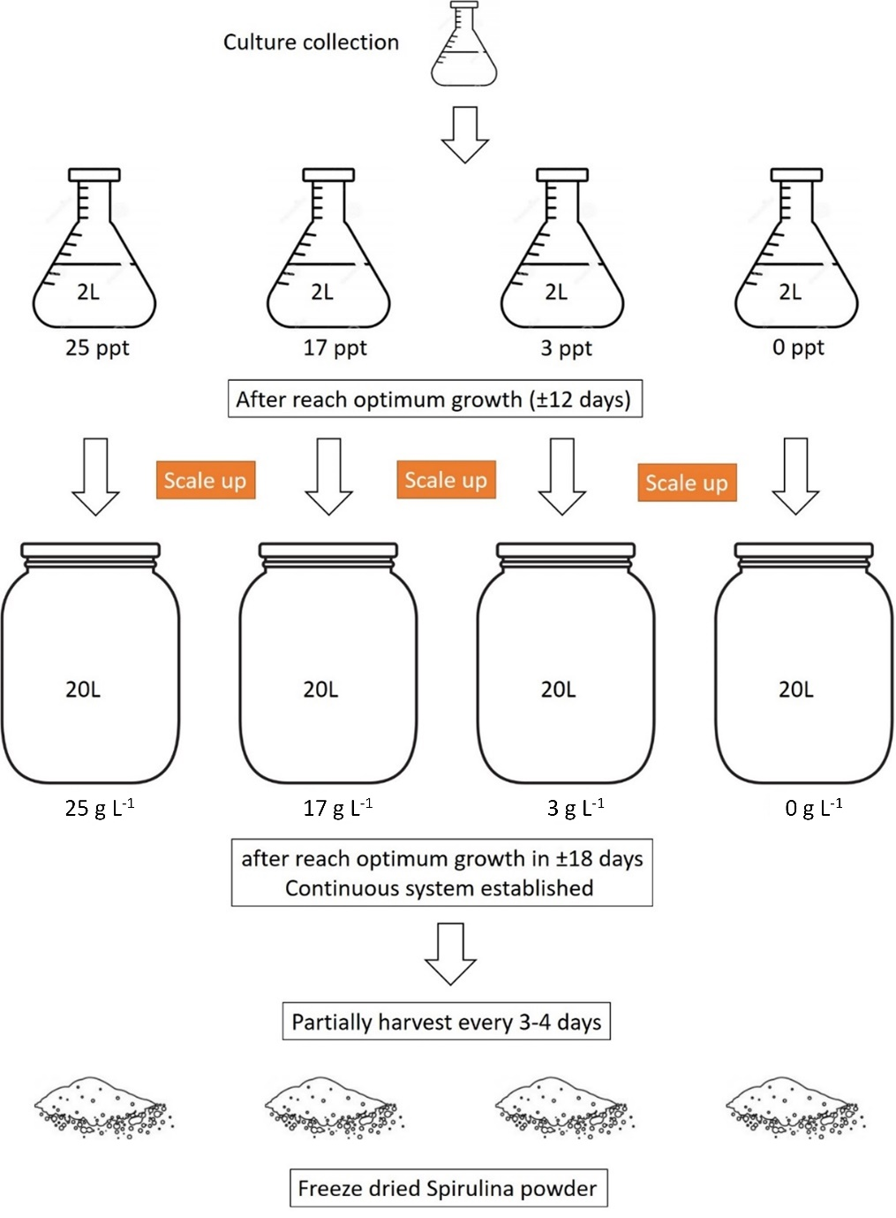
Figure S1. Culture conditions and preparation of Spirulina samples

